Slide 1
CS184 Milestone Status Report
Team Member: Changyi Yang, Zhexu Luo, Yuxuan Peng, Shaoqiang Sun

Slide 2
1
Project Overview
Main Purpose
Reconstruct Project 3 with GPU acceleration using Nvidia Optix,
a GPU ray tracing engine based on CUDA which contains an efficient set of
ray tracing programming interfaces and computing support.
Accomplish a path tracer on GPU using NVIDIA OptiX to support the
effects in project 3, including direct illumination, global illumination with
much faster speed.
Goal

Slide 3
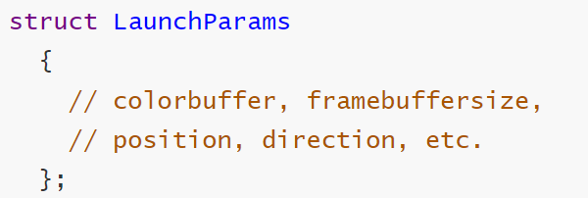
2
Current Progress
So far, we have managed to gain basic mastery and writing skill regarding GPU rendering with NVIDIA's Optix ray tracing engine.
Rendering Parameters
Settings
Optix Pipeline Settings
SBT Creating
Compiling and Launching
CUDA device setting, Optix render functions creating and pipeline creating
A collection of records providing high efficiency and extensibility
utilizing the GPU with parallel computing units and accelerate work
Future plans
Continue to dive into more in-depth domain knowledge of Optix, and expect to realize more complex ray tracing rendering such as microsurface materials and depth of field on the existing basis.

